Slide 1
APACHE SOLR
By Team Number - 07

Slide 2




Team Members
Hari Priya Jupally
Akshara Gurram
Vamsee Krishna Gangapatnam
Harish Reddy Vavilala

Slide 3
Topics To be Discussed:
Solr Introduction
Solr : Key Features
Solr : Architecture
Solr Admin UI
Solr Schema Hierarchy
Solr Core
Solr Documents and Fields
Solr Indexing Data
Solr Analysis
Solr Search Process
Solr Features
Configuring Solr Instances/Core
Solr Cloud Introduction
Features
Architecture
Job Trends for Apache Solr

Slide 4
Introduction
Solr is open source enterprise search server/web application.
Solr uses the Lucene Search Library and extends it
Solr exposes Lucene Java API’s as REST-Full services
You put documents in it (called indexing) via XML,JSON,CSV or binary over HTTP
You query it via HTTP GET and receive XML, CSV OR binary results

Slide 5
Solr: Key Features
Advanced Full-Text Search Capabilities
Optimized for High Volume Web Traffic
Standards Based Open Interfaces – XML, JSON and HTTP
Comprehensive HTML Administration Interfaces
Server statistics exposed over JMX for monitoring
Near Real-time indexing and Adaptable with XML Configuration
Linearly scalable, auto index replication, auto, Extensible Plugin Architecture

Slide 6
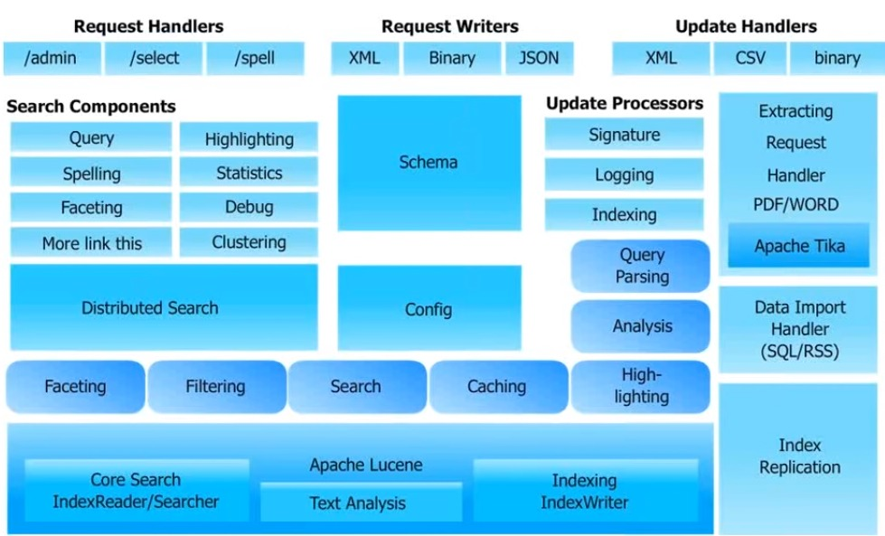
Solr: Architecture

Slide 7
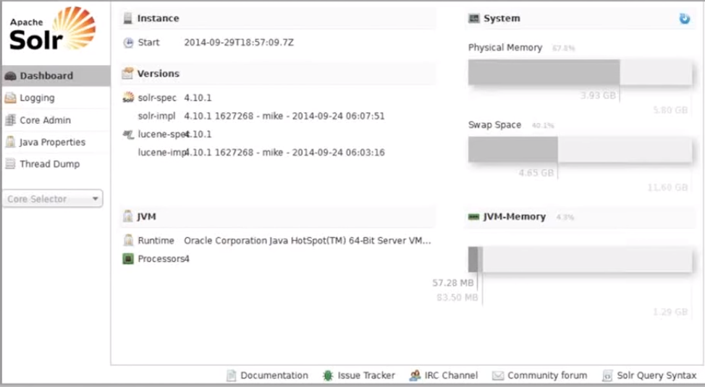
Solr: Admin UI

Slide 8
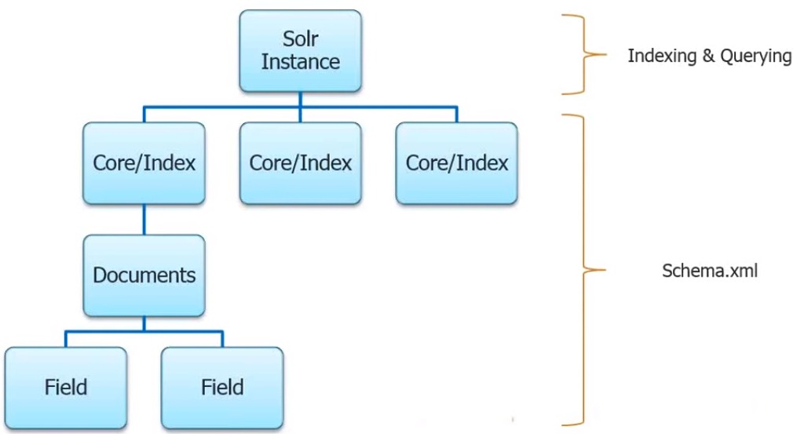
Solr: schema Hierarchy

Slide 9
Solr: Core
Solr Core: Also referred to as just a “Core”
This is a running instance of a Lucene index along with all the Solr configuration (SolrConfigXml, SchemaXml, etc..) required to use it
A single Solr application can contain 0 or more cores
Cores are run largely in isolation but can communicate with each other if necessary via the CoreContainer
Solr initially only supported one index, and the SolrCore class was a singleton for coordinating the low-level functionality at the “core” of Solr

Slide 10
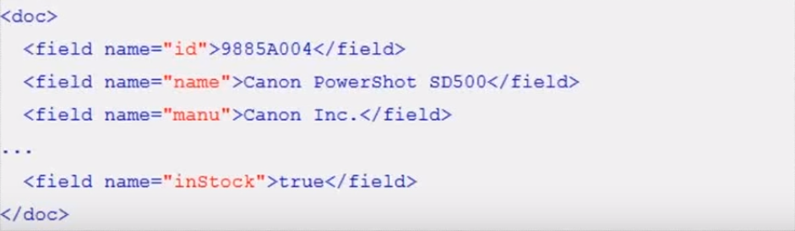
Solr: Documents & Fields
Solr’s basic unit of informantion is Document, which is the seet of data that describes something
Documents are composed of fields, which are most specific pieces of information
Fields can contain different kinds of data. A name field, for example, is text (character data)
The field type sells Solr how to interpret the field and how it can be queried

Slide 11
Solr: Indexing Data
A Solr index can accept data from many different sources, including XML files, comma-separated value (CSV) files, data extracted from tables in a database, and files in common file formats such as Microsoft Word or PDFs
Here are the three most common ways of loading data into a Solr index:
Uploading XML files by sending HTTP requests to the Solr
Using Index Handlers to Import from databases
Using the Solr Cell frameworkWriting a custom Java application to ingest data through Solr’s Java Client

Slide 12
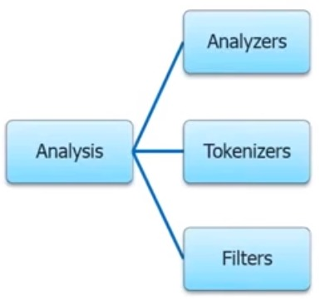
Solr: Analysis
There are three main concepts in analysis: analyzers, tokenizers, and filters
Analyzers are used both during, when a document is indexed, and at query time
The same analysis process need not be used for both operations
An analyzer examines the text of fields and generates a token stream
Analyzers may be a single class or they may be composed of a series of tokenizers and filter classes
Tokenizers break field data into lexical units, or tokens
Filters examine a stream of tokens and keep them, transform or discard them, or create new ones

Slide 13
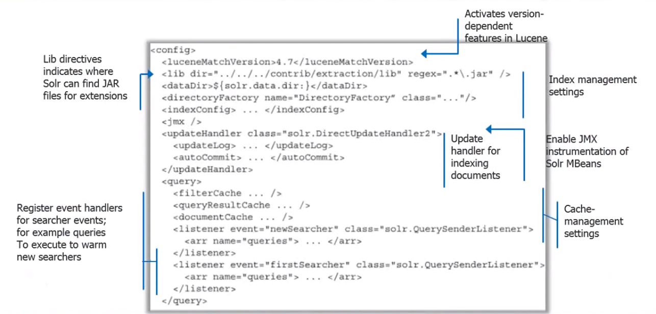
Solr: solrconfig.xml

Slide 14
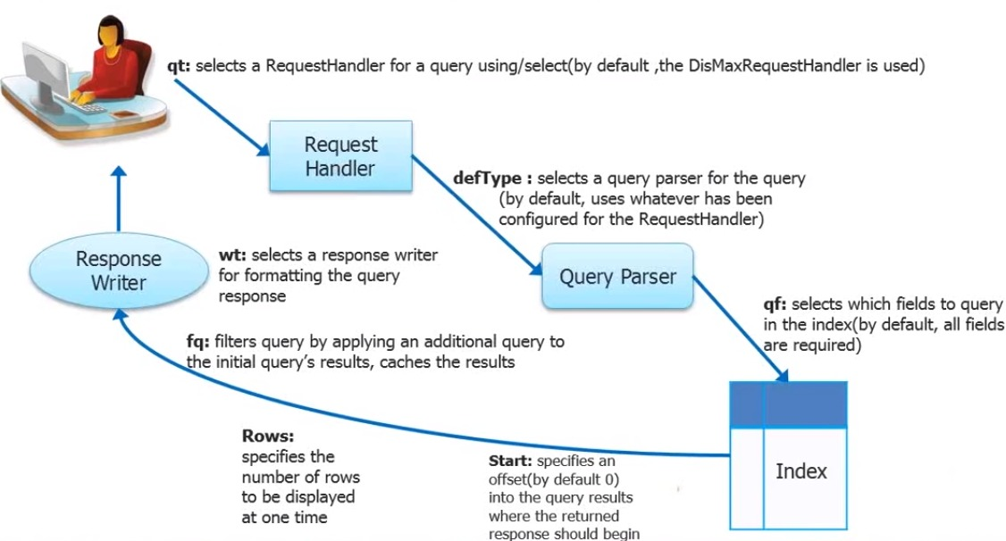
Solr: Search Process

Slide 15
Solr: Features
Faceting
Highlighting
Spell Checking
Query Re-ranking
Transforming
Suggestors
More Like This
Pagination
Grouping & Clustering
Spatial Search
Components
Real time (Get & Update)
LABS

Slide 16
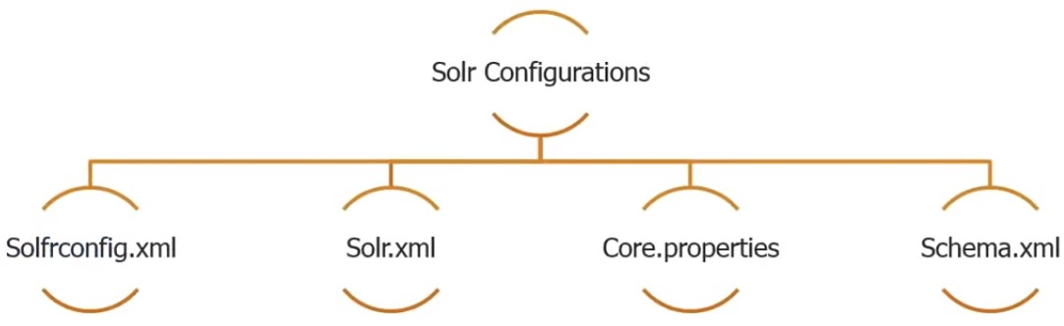
Configuring Solr Instances / Cores

Slide 17
Solr: Cloud Introduction
Apache Solr includes the ability to set up a cluster of Solr servers that combines fault tolerance and high availability called SolrCloud
SolrCloud is flexible distributed search and Indexing, without a master node to allocate nodes, shards and replicas
Solr uses Zookeeper to manage these locations, depending on configuration files and schemas
Documents can be sent to any server and Zookeeper will figure it out

Slide 18
Features:
Horizontal Scaling(For Sharding & Replication)
Elastic Scaling
High Availability
Distributed Indexing
Distributed Searching
Central Configuration for entire cluster
Automatic Lad Balancing
Automatic Failover for queries
Zookeeper Integration For Coordination & Configuration

Slide 19
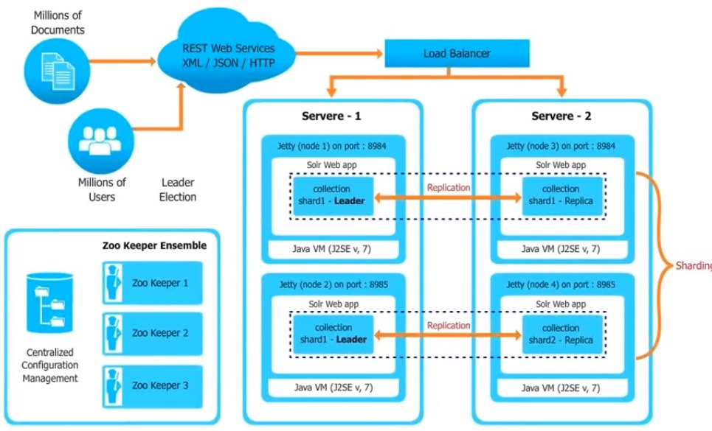
SolrCloud

Slide 20
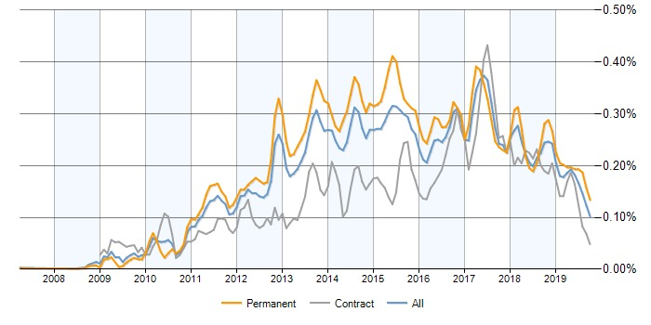
Job trends for Apache Solr

Slide 21
Demo….!!

Slide 22
Any Questions ??

Slide 23
Thank you…!!!

